Slide 1
Logical Agents
Md Mehrab Hossain Opi
CSE 4109: Artificial Intelligence

Slide 2
Introduction
Problem-solving agents know only limited information about states and actions.
They perform poorly in complex, dynamic real-world environments where unexpected situations can arise.
We need knowledge-based agents that can represent facts about the world, reason with them, and adapt their actions to new situations.

Slide 3
Knowledge-based Agent
A knowledge-based agent is an intelligent system that uses a knowledge base of facts and rules, together with an inference mechanism, to reason about the world and decide on appropriate actions.

Slide 4
Knowledge-based Agent
Imagine a robot delivery agent.
Consider the sentences it knows
If it rains, the ground will be wet.
If the garden is wet, avoid the garden path.
The garden path is the shortest route.
During delivery robot perceives that it is raining.
It will infer that ground will be wet and it should be avoided.
Hence, it will take the longer road around.

Slide 5
Knowledge Base
The central component of a knowledge-based agent.
A KB is a set of sentences.
Not traditional English sentence.
Expressed with knowledge representation language.
An axiom is a sentence that is not derived from other sentences.

Slide 6
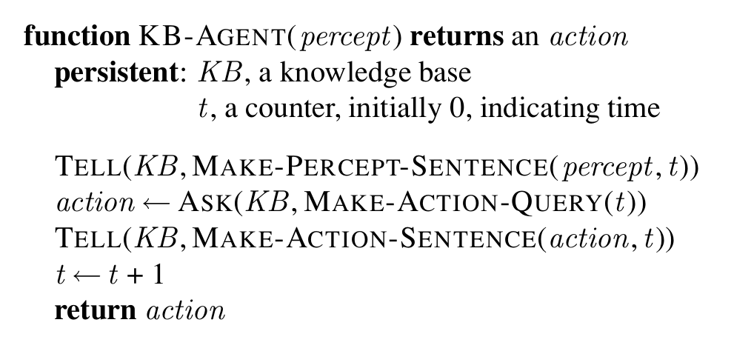
A Generic Knowledge-based Agent

Slide 7
A Generic Knowledge-based Agent
Each time the agent is called
It TELLS the knowledge base what it perceives.
It ASKS the kb what action it should perform.
It TELLS the kb which action was chosen and the agent executes the action.
Details of the inference system are hidden inside TELL & ASK.

Slide 8
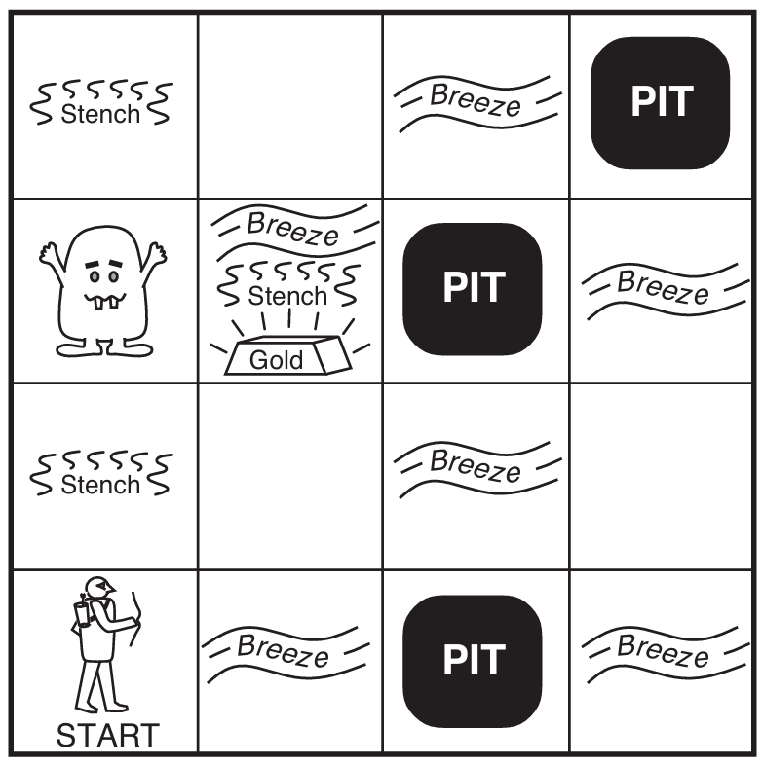
The Wumpus World
Let’s see an environment where the knowledge-based agents can show their worth.
The Wumpus world is a cave consisting of rooms connected by passageways.
A Wumpus lives somewhere in the cave.
It eats anyone who enter its room.
The agent can kill the beast.
But it has only one arrow.

Slide 9
The Wumpus World
Some rooms contain bottomless pits.
Agent dies by falling if it enters the room.
The Wumpus won’t die though.
The only good thing about this cave is the treasure hidden inside.

Slide 10
The Wumpus World
Let’s define the PEAS now.
Performance Measure
+1000 for climbing out of the cave with the gold.
-1000 for dying.
-1 for each action taken.
-10 for using up the arrow.

Slide 11
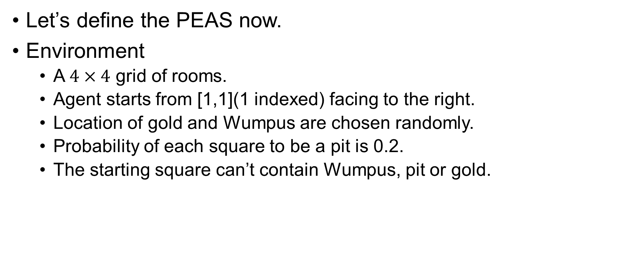
The Wumpus World
Let’s define the PEAS now.
Environment
A $4×4$ grid of rooms.
Agent starts from [1,1](1 indexed) facing to the right.
Location of gold and Wumpus are chosen randomly.
Probability of each square to be a pit is 0.2.
The starting square can’t contain Wumpus, pit or gold.

Slide 12
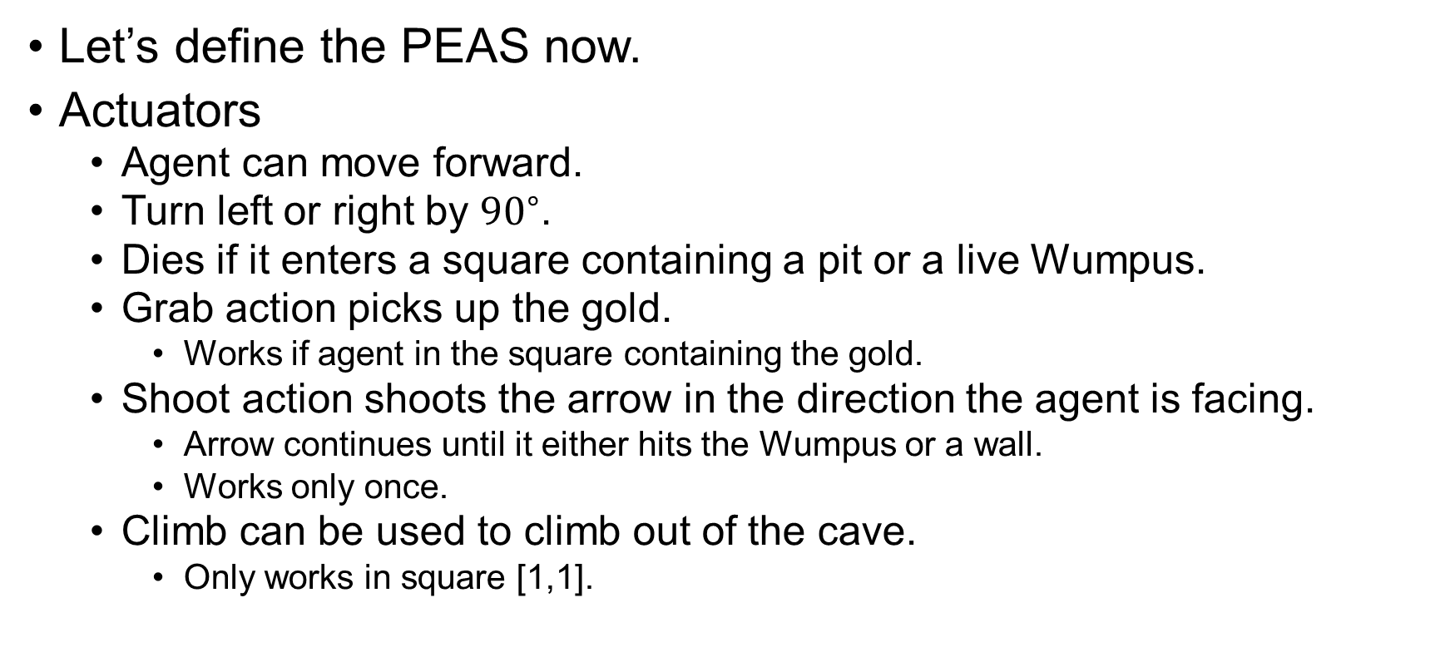
The Wumpus World
Let’s define the PEAS now.
Actuators
Agent can move forward.
Turn left or right by ${90}^{∘}$.
Dies if it enters a square containing a pit or a live Wumpus.
Grab action picks up the gold.
Works if agent in the square containing the gold.
Shoot action shoots the arrow in the direction the agent is facing.
Arrow continues until it either hits the Wumpus or a wall.
Works only once.
Climb can be used to climb out of the cave.
Only works in square [1,1].

Slide 13
The Wumpus World
Let’s define the PEAS now.
Sensors
The agent has 5 sensors.
The square containing the Wumpus and in the directly adjacent(not diagonally) squares, the agent will perceive a Stench.
In the square directly adjacent to a pit, the agent will perceive a Breeze.
In the square where the gold is, the agent will perceive a Glitter.
When an agent bumps into a wall, it will perceive a Bump.
When the Wumpus is killed, it emits a woeful Scream that can be perceived from anywhere in the cave.
The Percepts will be given in the form of a list of five symbols.

Slide 14
The Wumpus World
Now let’s see how a knowledge-based agent can work in this world.
We will use an informal knowledge representation.
Writing down symbols in a grid.

Slide 15
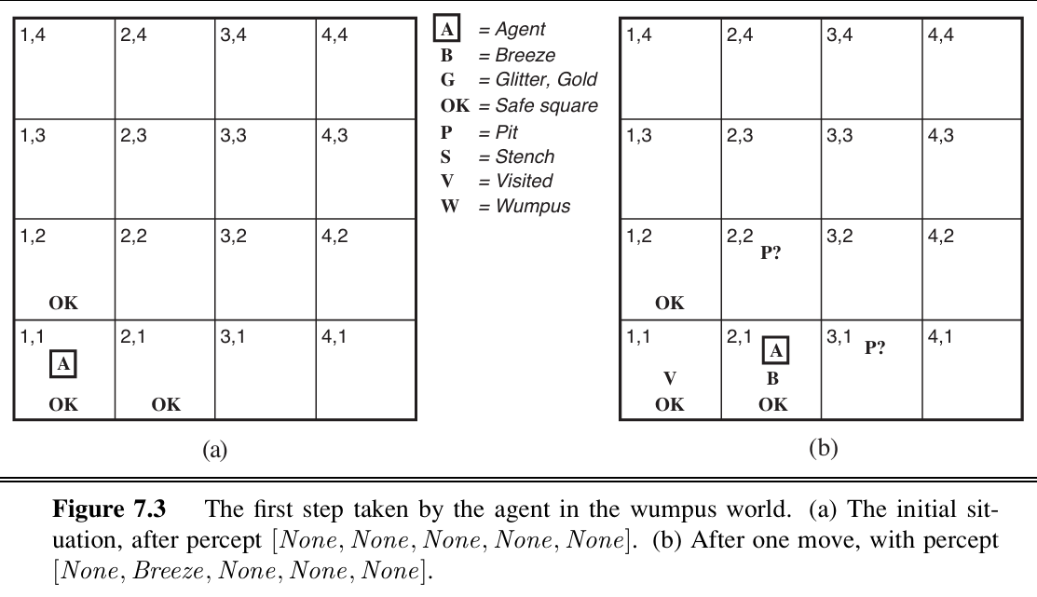
The Wumpus World

Slide 16
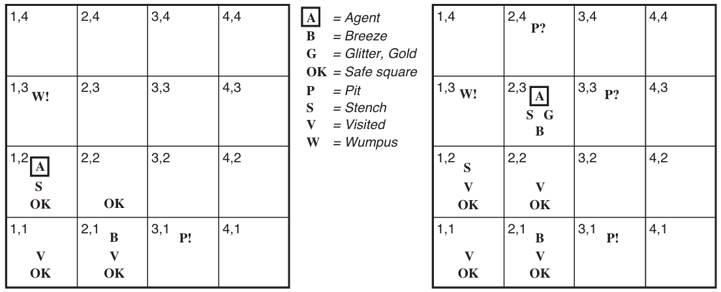
The Wumpus World

Slide 17
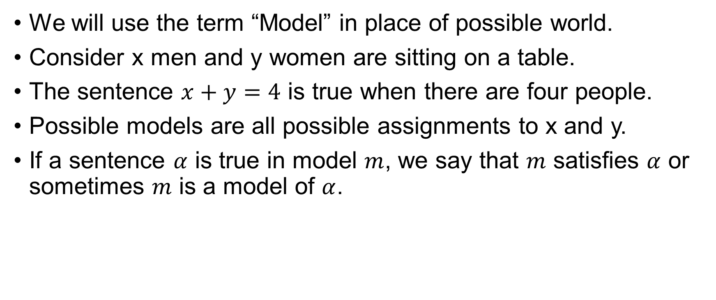
Logic
We will use the term “Model” in place of possible world.
Consider x men and y women are sitting on a table.
The sentence $x+y=4$ is true when there are four people.
Possible models are all possible assignments to x and y.
If a sentence $α$ is true in model $m$, we say that $m$ satisfies $α$ or sometimes $m$ is a model of $α$.

Slide 18
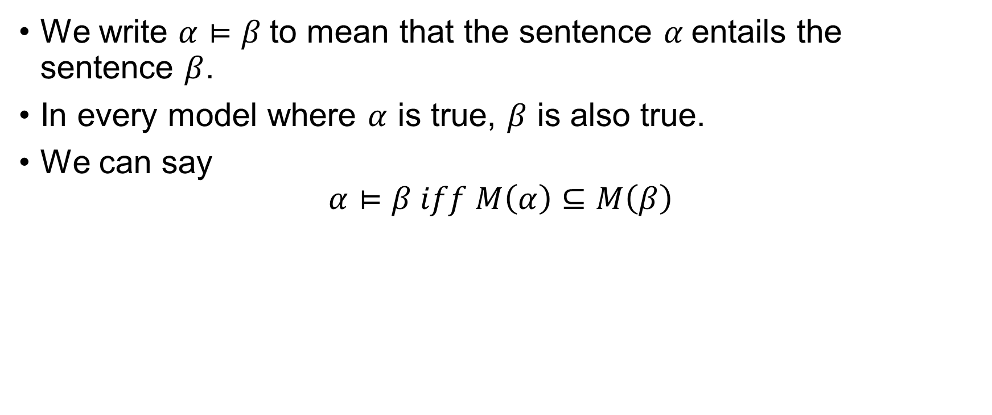
Entailment
We write $α⊨β$to mean that the sentence $α$entails the sentence $β$.
In every model where $α$ is true, $β$ is also true.
We can say
$$α⊨β iff M\left(α\right)⊆M\left(β\right)$$

Slide 19
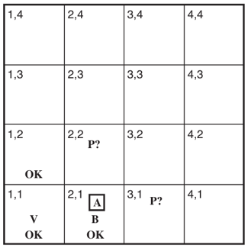
Entailment
Remember the Wumpus World?

Slide 20
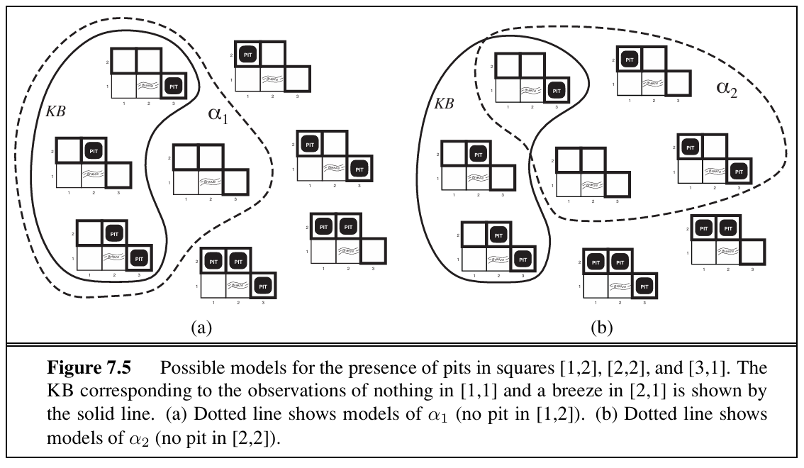
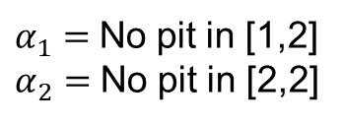
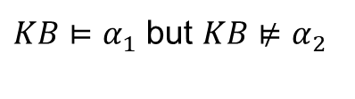
Entailment
$α_{1}=$No pit in [1,2]
$α_{2}=$No pit in [2,2]
$KB⊨α_{1}$ but $KB⊭α_{2}$

Slide 21
Propositional Logic

Slide 22
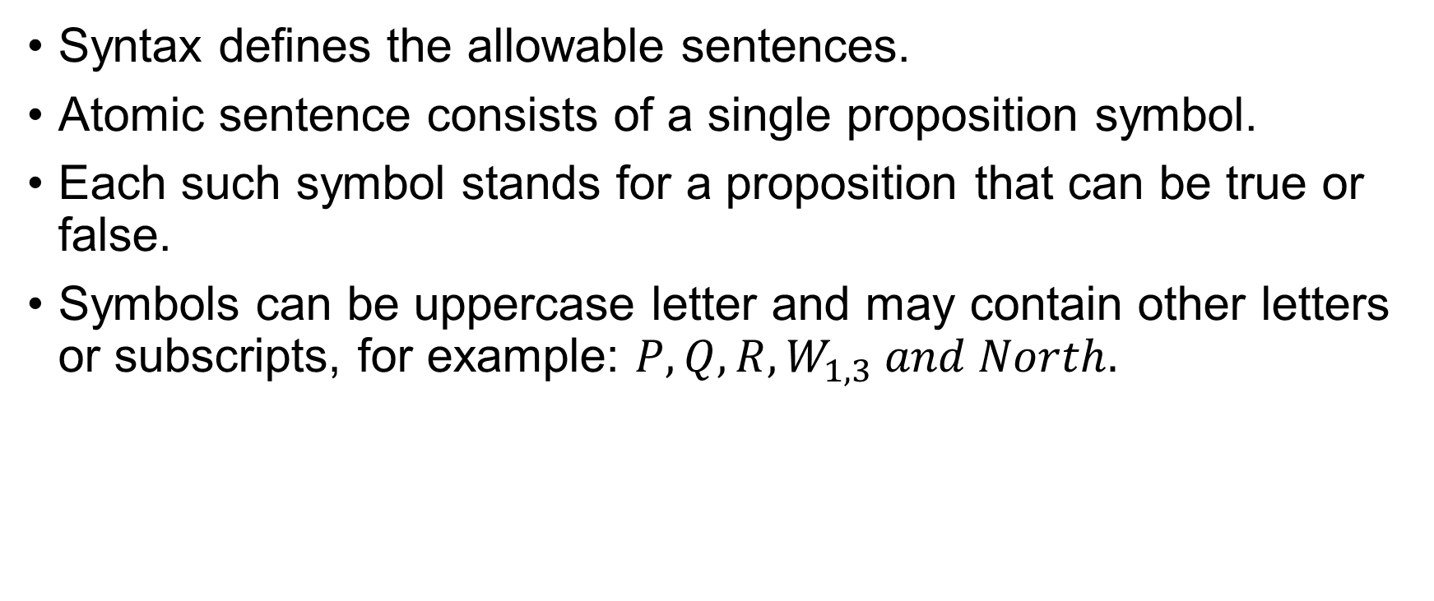
Syntax
Syntax defines the allowable sentences.
Atomic sentence consists of a single proposition symbol.
Each such symbol stands for a proposition that can be true or false.
Symbols can be uppercase letter and may contain other letters or subscripts, for example: $P, Q, R, W_{1,3} and North.$

Slide 23
Syntax
There are two proposition symbols with fixed meanings:
True is the always-true proposition and
False is the always-false proposition.
Complex sentences are constructed from simpler sentences, using parentheses and logical connectives.

Slide 24
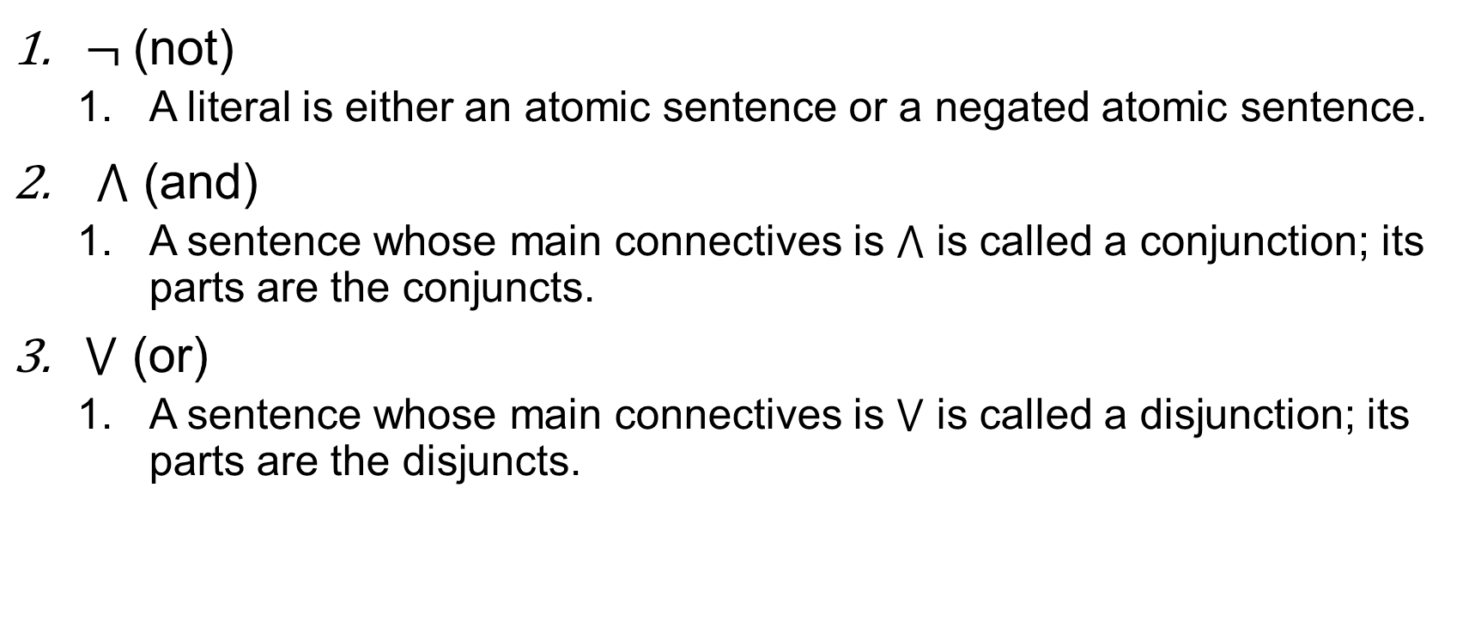
Common Connectives
$¬$(not)
A literal is either an atomic sentence or a negated atomic sentence.
$⋀$ (and)
A sentence whose main connectives is $⋀$ is called a conjunction; its parts are the conjuncts.
$⋁$ (or)
A sentence whose main connectives is $⋁$ is called a disjunction; its parts are the disjuncts.

Slide 25
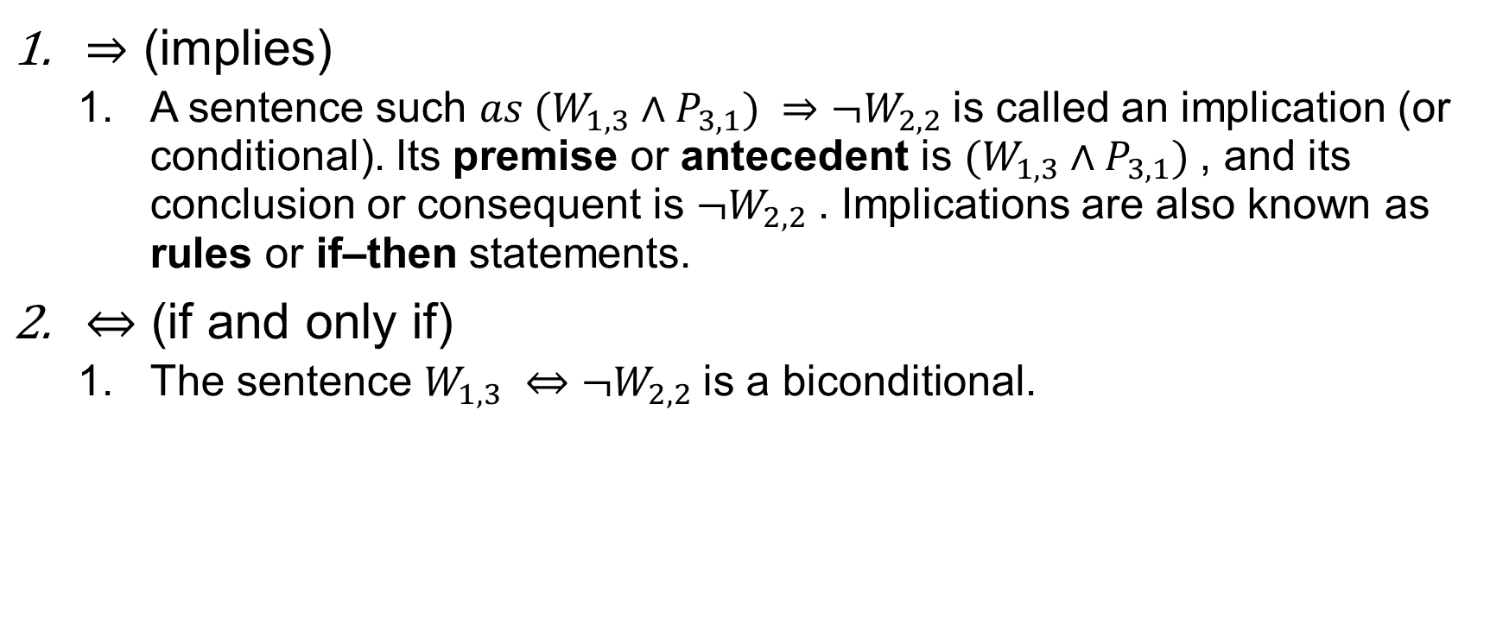
$⇒$ (implies)
A sentence such $as (W_{1,3}∧P_{3,1}) ⇒¬W_{2,2}$is called an implication (or conditional). Its premise or antecedent is $(W_{1,3}∧P_{3,1})$, and its conclusion or consequent is $¬W_{2,2}$. Implications are also known as rules or if–then statements.
$⇔$ (if and only if)
The sentence $W_{1,3} ⇔¬W_{2,2}$is a biconditional.

Slide 26
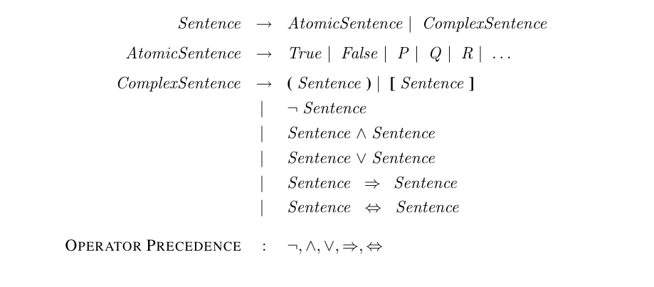
Grammar of Sentences in Propositional Logic

Slide 27
Semantics
Semantics defines the rules for determining the truth of a sentence with respect to a particular model.
Must specify how to compute the truth value of any sentence, given a model.
Done recursively.
We need to specify how to compute the truth of atomic sentences and how to compute the truth of sentences formed with each of the five connectives.

Slide 28
Semantics
Atomic sentences are easy:
True is true in every model and False is false in every model.
The truth value of every other proposition symbol must be specified directly in the model.

Slide 29
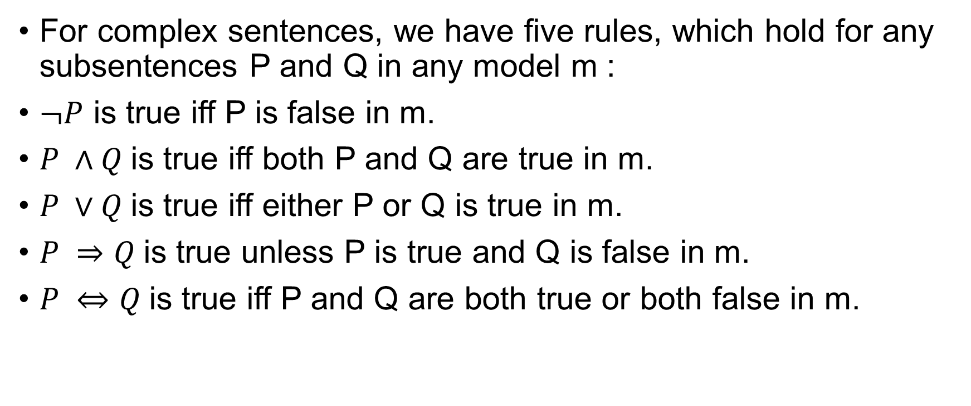
Semantics
For complex sentences, we have five rules, which hold for any subsentences P and Q in any model m :
$¬P$ is true iff P is false in m.
$P ∧Q$is true iff both P and Q are true in m.
$P ∨Q$is true iff either P or Q is true in m.
$P ⇒Q$is true unless P is true and Q is false in m.
$P ⇔Q$is true iff P and Q are both true or both false in m.

Slide 30
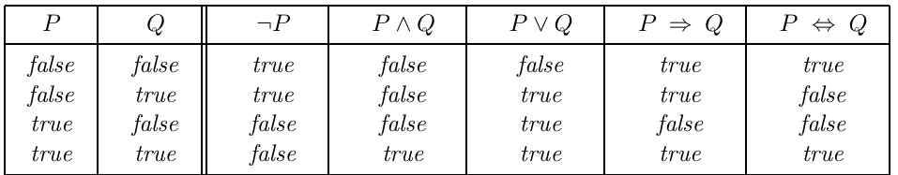
Semantics
The rules can also be expressed with truth tables.

Slide 31
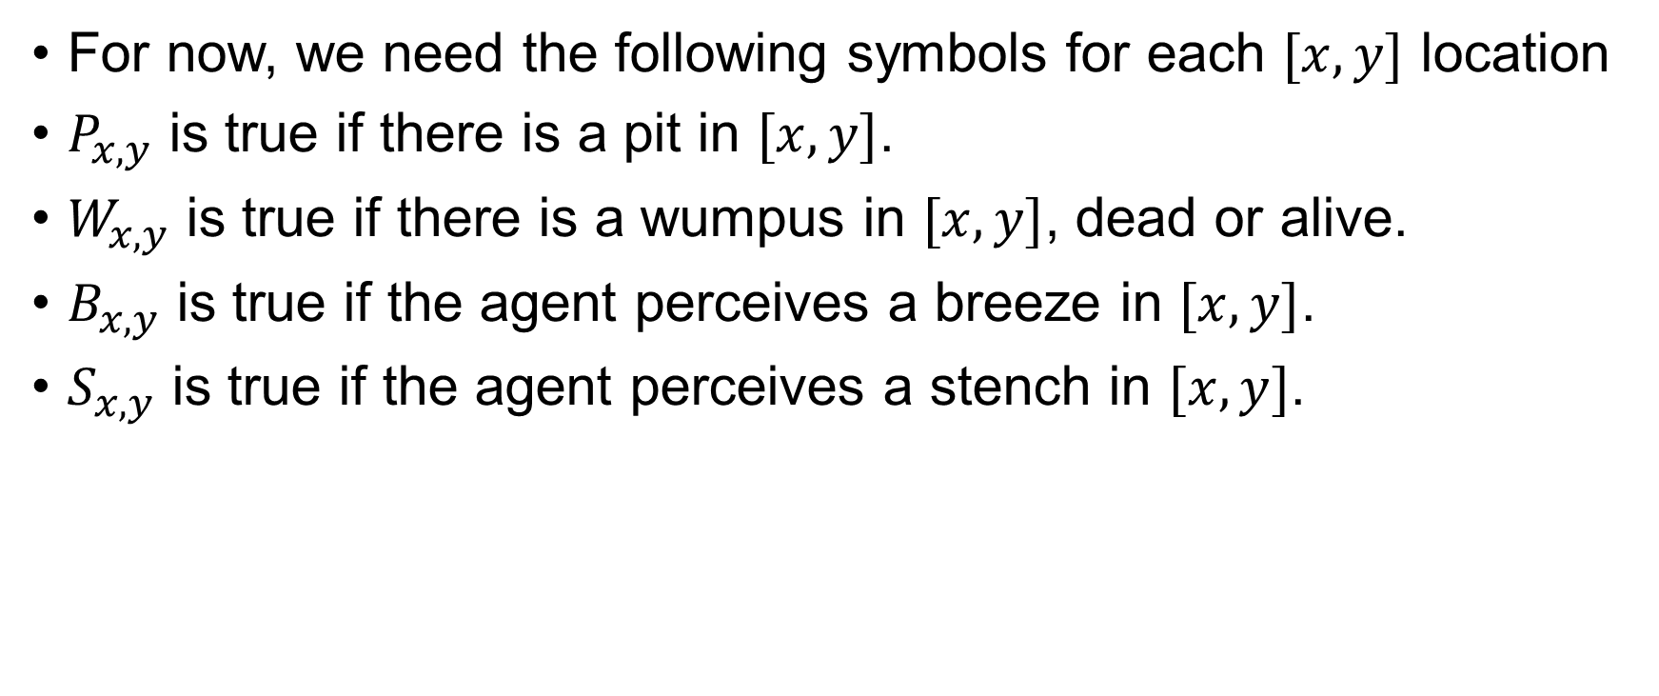
A simple Knowledge Base
For now, we need the following symbols for each $[x,y]$ location
$P_{x,y}$ is true if there is a pit in $[x,y]$.
$W_{x,y}$ is true if there is a wumpus in $[x,y]$, dead or alive.
$B_{x,y}$ is true if the agent perceives a breeze in $[x,y]$.
$S_{x,y}$ is true if the agent perceives a stench in $[x,y]$.

Slide 32
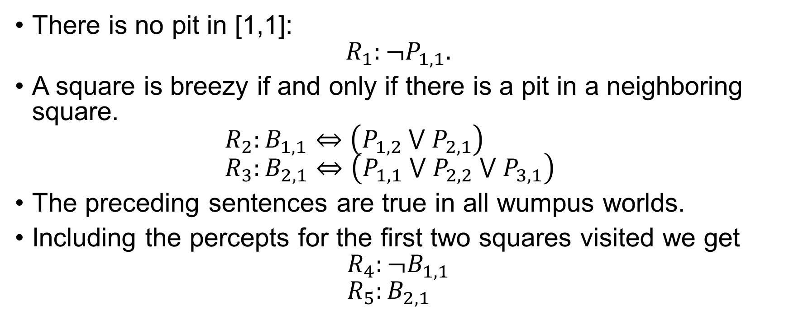
A simple Knowledge Base
There is no pit in [1,1]: $R_{1}:¬P_{1,1}.$
A square is breezy if and only if there is a pit in a neighboring square. $R_{2}:B_{1,1}⇔\left(P_{1,2} ⋁{ P}_{2,1}\right)$ $R_{3}:B_{2,1}⇔\left(P_{1,1} ⋁{ P}_{2,2} ⋁{ P}_{3,1}\right)$
The preceding sentences are true in all wumpus worlds.
Including the percepts for the first two squares visited we get $R_{4}:¬B_{1,1}$ $R_{5}:B_{2,1}$

Slide 33
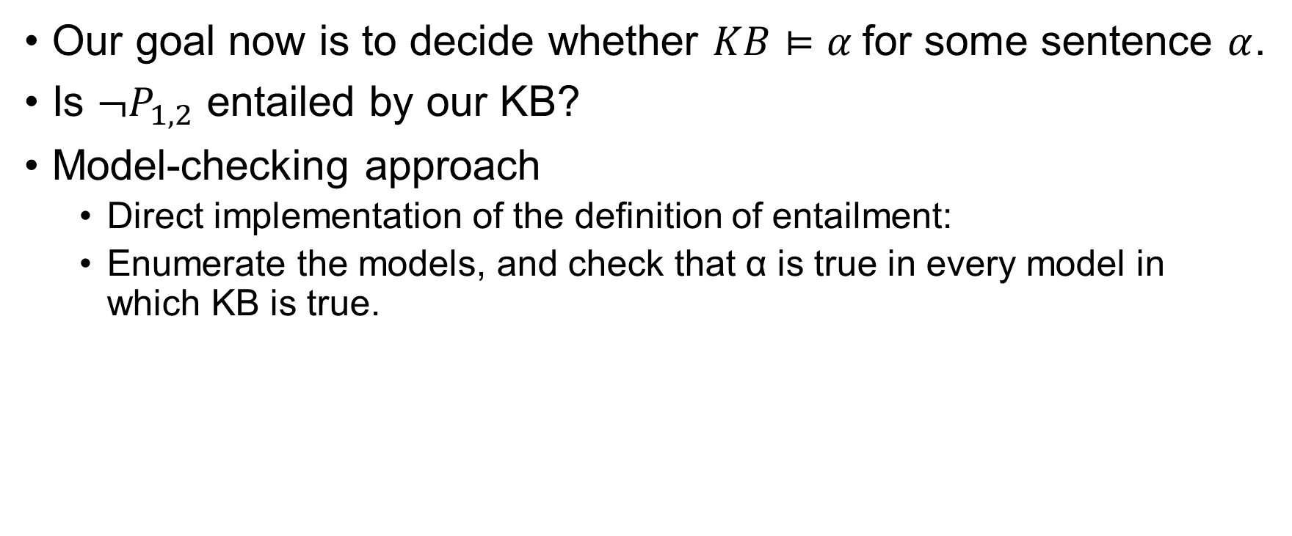
A Simple Inference Procedure
Our goal now is to decide whether $KB⊨α$for some sentence $α$.
Is $¬P_{1,2}$ entailed by our KB?
Model-checking approach
Direct implementation of the definition of entailment:
Enumerate the models, and check that α is true in every model in which KB is true.

Slide 34
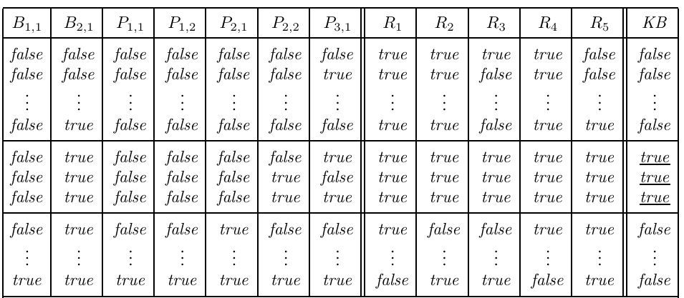
A Simple Inference Procedure

Slide 35
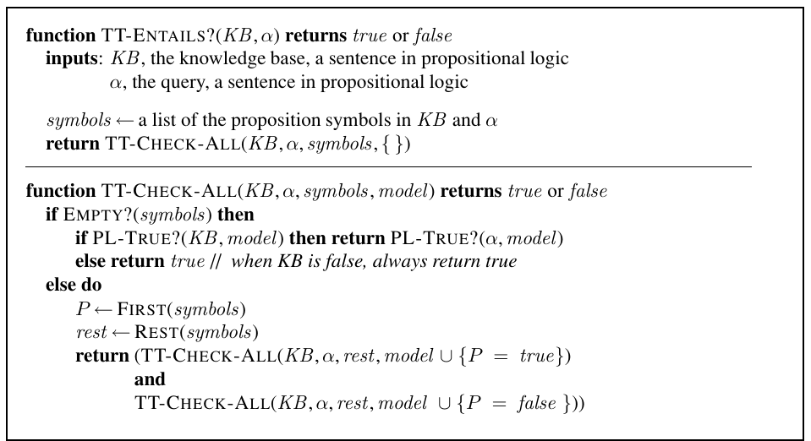
A Simple Inference Procedure

Slide 36
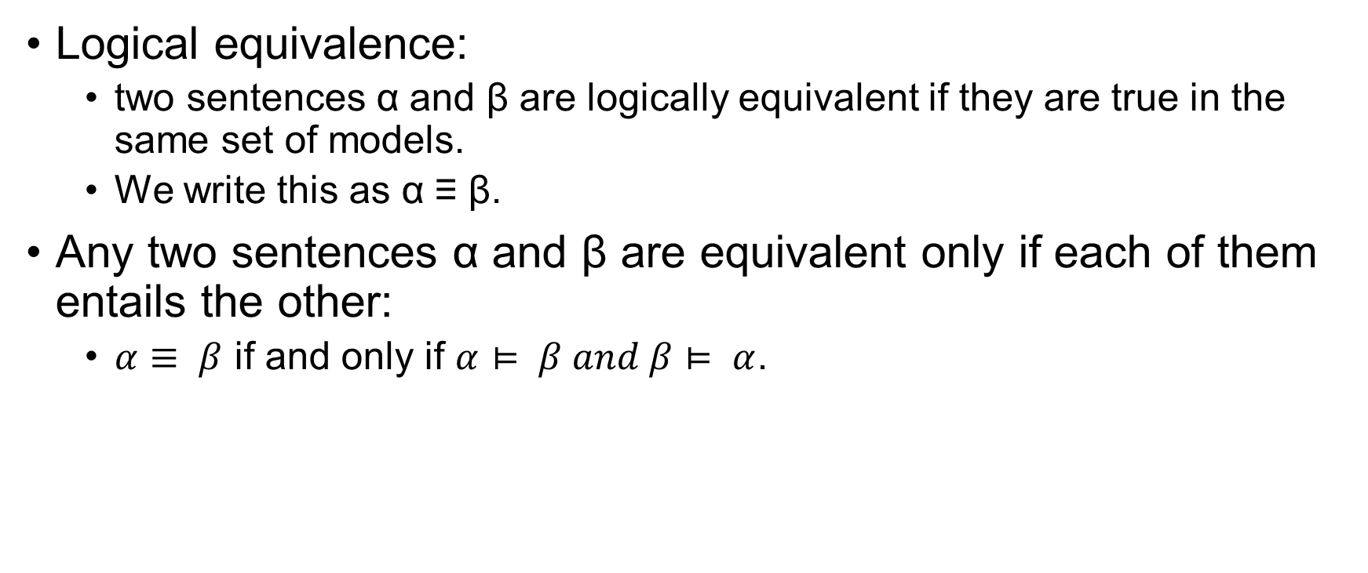
Propositional Theorem Proving
Logical equivalence:
two sentences α and β are logically equivalent if they are true in the same set of models.
We write this as α ≡ β.
Any two sentences α and β are equivalent only if each of them entails the other:
$α≡ β$ if and only if $α⊨ β and β⊨ α$.

Slide 37
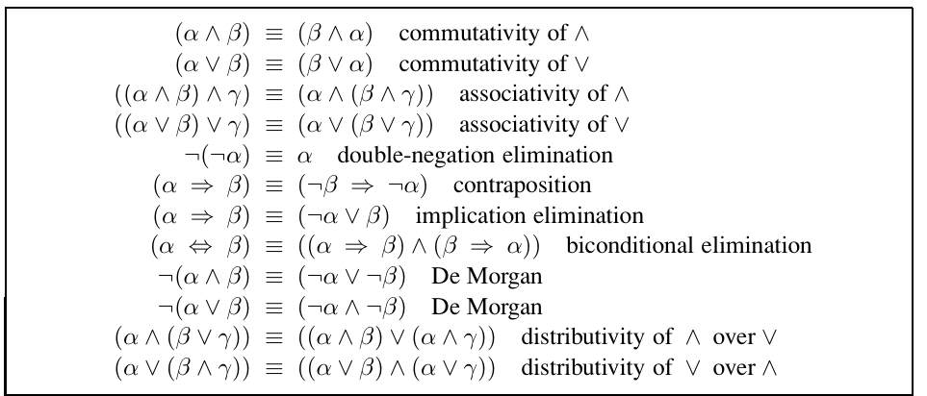
Logical Equivalence

Slide 38
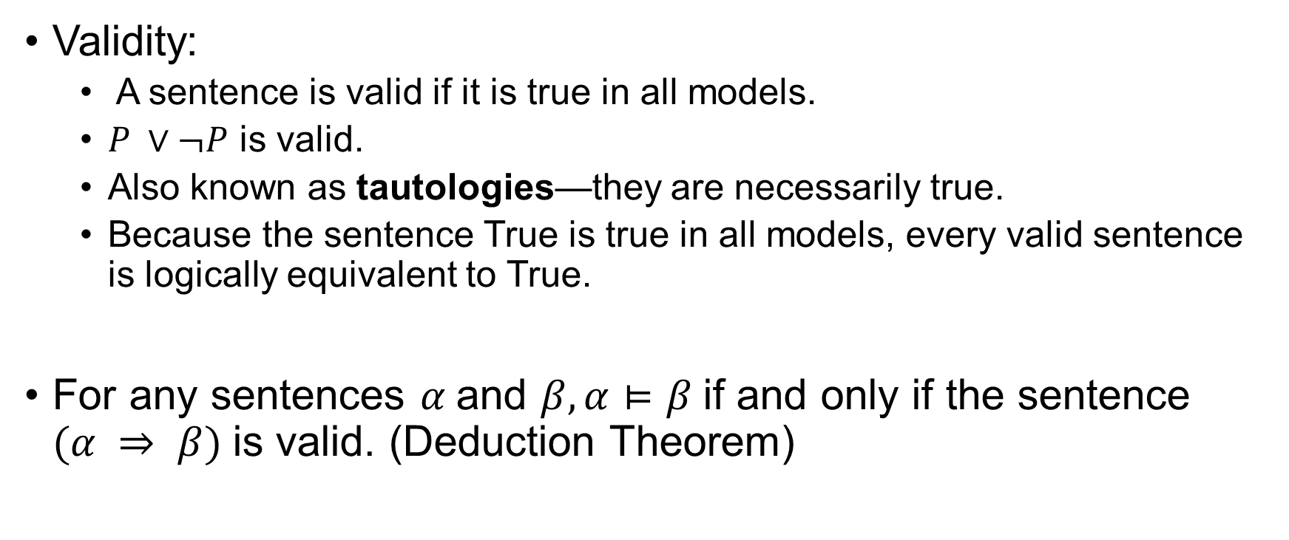
Propositional Theorem Proving
Validity:
A sentence is valid if it is true in all models.
$P ∨¬P$ is valid.
Also known as tautologies—they are necessarily true.
Because the sentence True is true in all models, every valid sentence is logically equivalent to True.
For any sentences $α$and $β, α⊨β$if and only if the sentence $(α ⇒ β)$is valid. (Deduction Theorem)

Slide 39
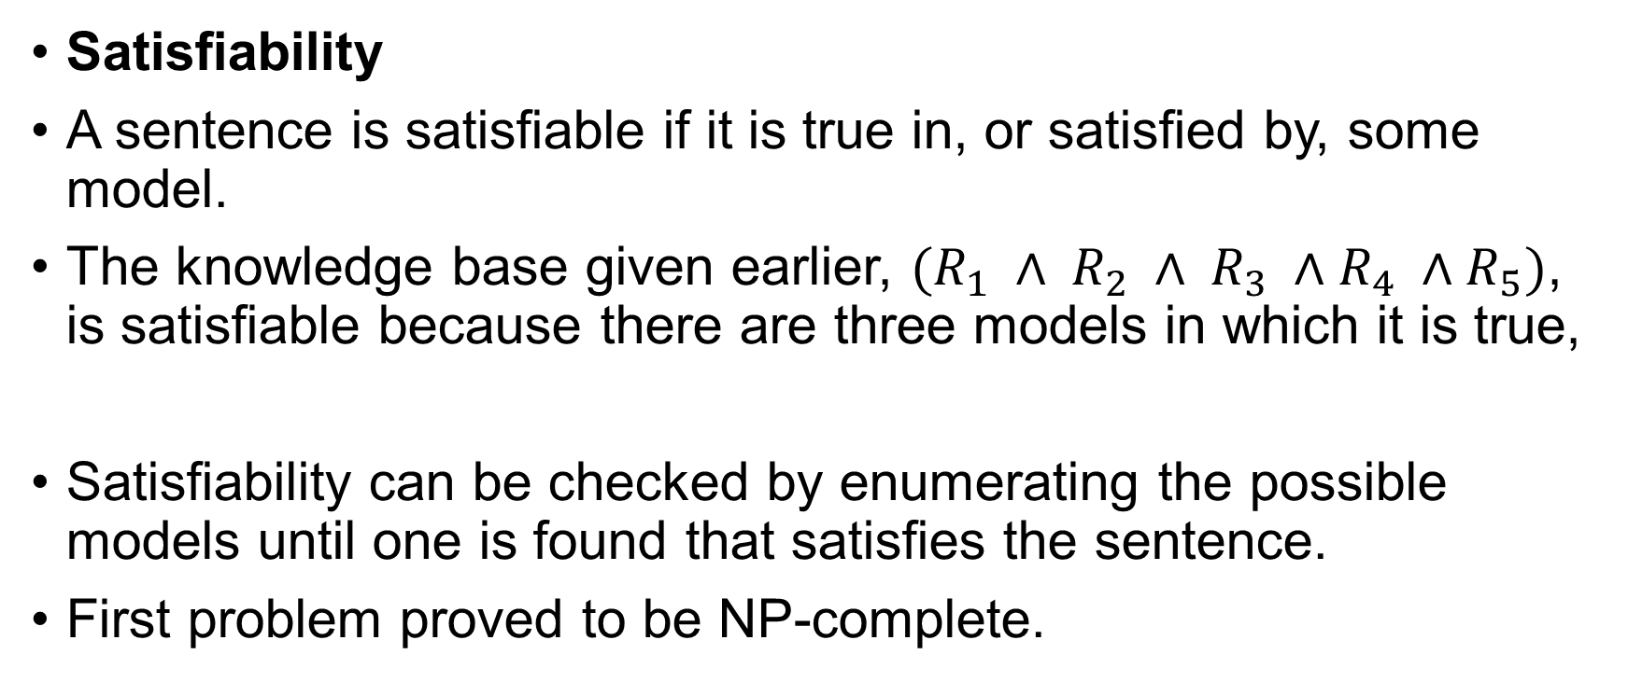
Propositional Theorem Proving
Satisfiability
A sentence is satisfiable if it is true in, or satisfied by, some model.
The knowledge base given earlier, $(R_{1} ∧ R_{2} ∧ R_{3} ∧R_{4} ∧R_{5})$, is satisfiable because there are three models in which it is true,
Satisfiability can be checked by enumerating the possible models until one is found that satisfies the sentence.
First problem proved to be NP-complete.

Slide 40
Propositional Theorem Proving
Validity and satisfiability are of course connected:
α is valid iff ¬α is unsatisfiable; contrapositively, α is satisfiable iff ¬α is not valid.
We also have the following useful result: α |= β if and only if the sentence (α ∧¬β) is unsatisfiable.

Slide 41
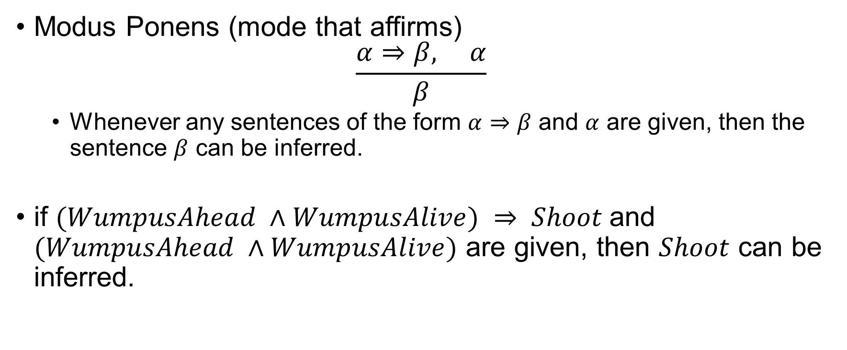
Inference Rules
Modus Ponens (mode that affirms) $\frac{α⇒β, α}{β}$
Whenever any sentences of the form $α⇒β$ and $α$ are given, then the sentence $β$ can be inferred.
if $(WumpusAhead ∧WumpusAlive) ⇒ Shoot$and $(WumpusAhead ∧WumpusAlive)$ are given, then $Shoot$ can be inferred.

Slide 42

Inference Rules
And-Elimination $\frac{α \bigwedge{ }β}{β}$
From $(WumpusAhead ∧ WumpusAlive)$, $WumpusAlive$ can be inferred.

Slide 43

Inference Rules
All the logical equivalence rules can be used as inference rules. $\frac{α⇔β}{\left(α⇒β\right)\bigwedge{ (β⇒α)}} and\frac{\left(α⇒β\right)\bigwedge{ (β⇒α)}}{α⇔β}$

Slide 44
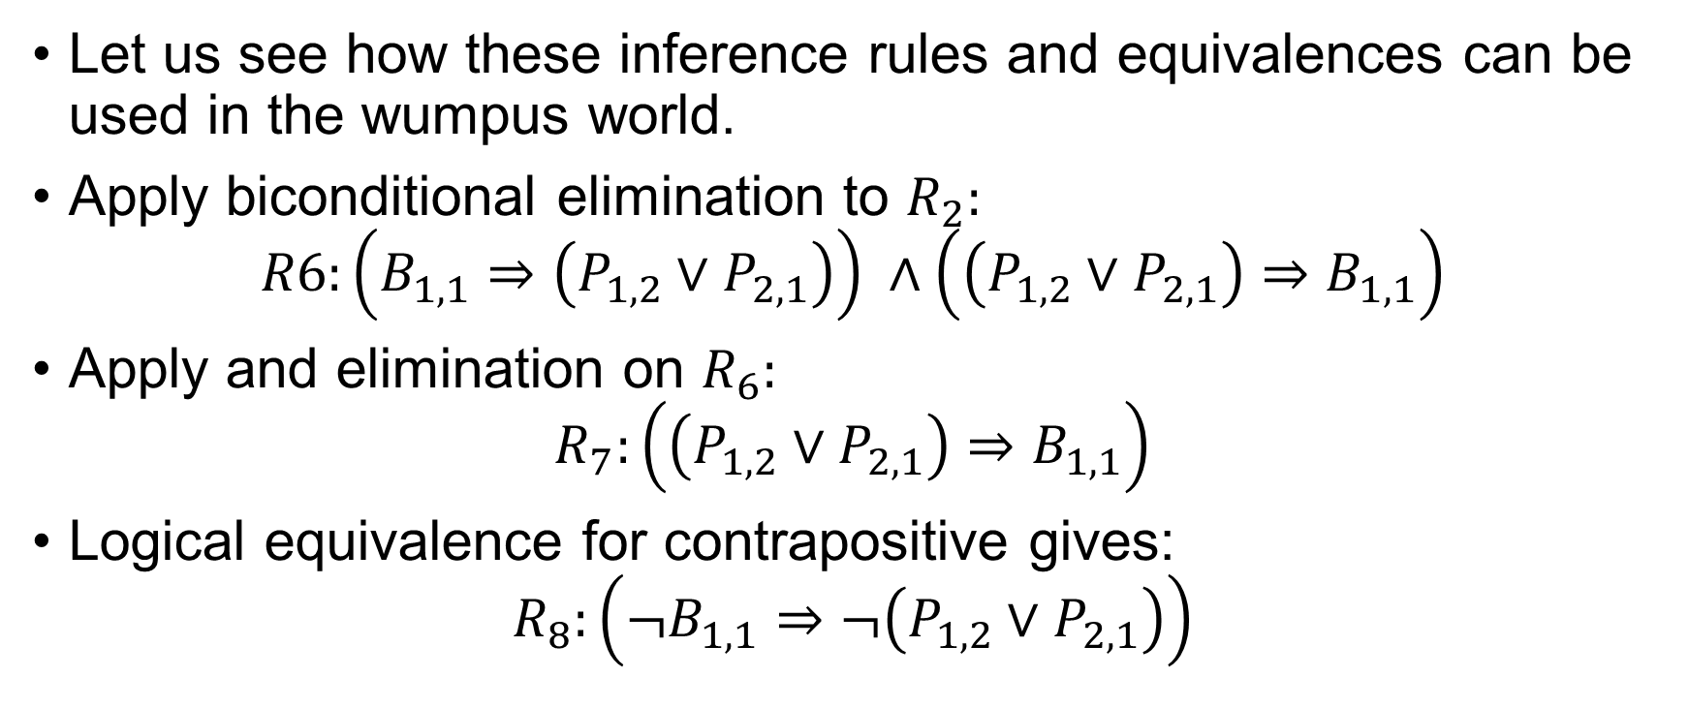
Inference Rules
Let us see how these inference rules and equivalences can be used in the wumpus world.
Apply biconditional elimination to $R_{2}:$ $R6:\left(B_{1,1}⇒\left(P_{1,2}∨P_{2,1}\right)\right) ∧\left(\left(P_{1,2}∨P_{2,1}\right)⇒B_{1,1}\right)$
Apply and elimination on $R_{6}:$ $R_{7}:\left(\left(P_{1,2}∨P_{2,1}\right)⇒B_{1,1}\right)$
Logical equivalence for contrapositive gives: $R_{8}:\left(¬B_{1,1}⇒¬\left(P_{1,2}∨P_{2,1}\right)\right)$

Slide 45

Inference Rules
Apply Modus Ponens with $R_{8}$ and the percept $R_{4}:$ $R_{9}:¬\left(P_{1,2}∨P_{2,1}\right)$
Finally, we apply De Morgan’s rule, giving the conclusion $R_{10}:¬P_{1,2}∨¬P_{2,1}$

Slide 46
Inference Rules
We can apply search algorithms to find a sequence of steps that constitutes a proof.
INITIAL STATE: the initial knowledge base.
ACTIONS: the set of actions consists of all the inference rules applied to all the sentences that match the top half of the inference rule.
RESULT: the result of an action is to add the sentence in the bottom half of the inference rule.
GOAL: the goal is a state that contains the sentence we are trying to prove.

Slide 47
Inference Rules
Monotonicity
The set of entailed sentences can only increase as information is added to the knowledge base.
For any sentences α and β, if KB |= α then KB ∧β |=α.

Slide 48
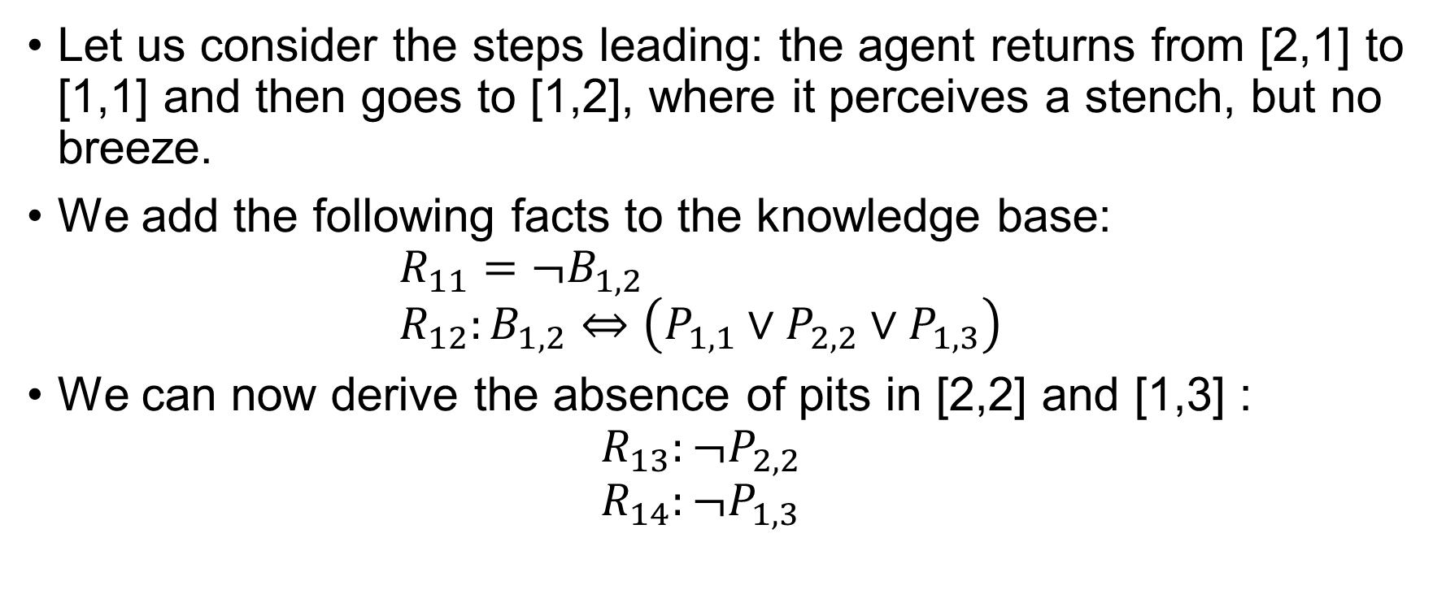
Proof by Resolution
Let us consider the steps leading: the agent returns from [2,1] to [1,1] and then goes to [1,2], where it perceives a stench, but no breeze.
We add the following facts to the knowledge base: $R_{11}=¬B_{1,2}$ $R_{12}:B_{1,2}⇔\left(P_{1,1}∨P_{2,2}∨P_{1,3}\right)$
We can now derive the absence of pits in [2,2] and [1,3] : $R_{13}:¬P_{2,2}$ $R_{14}:¬P_{1,3}$

Slide 49
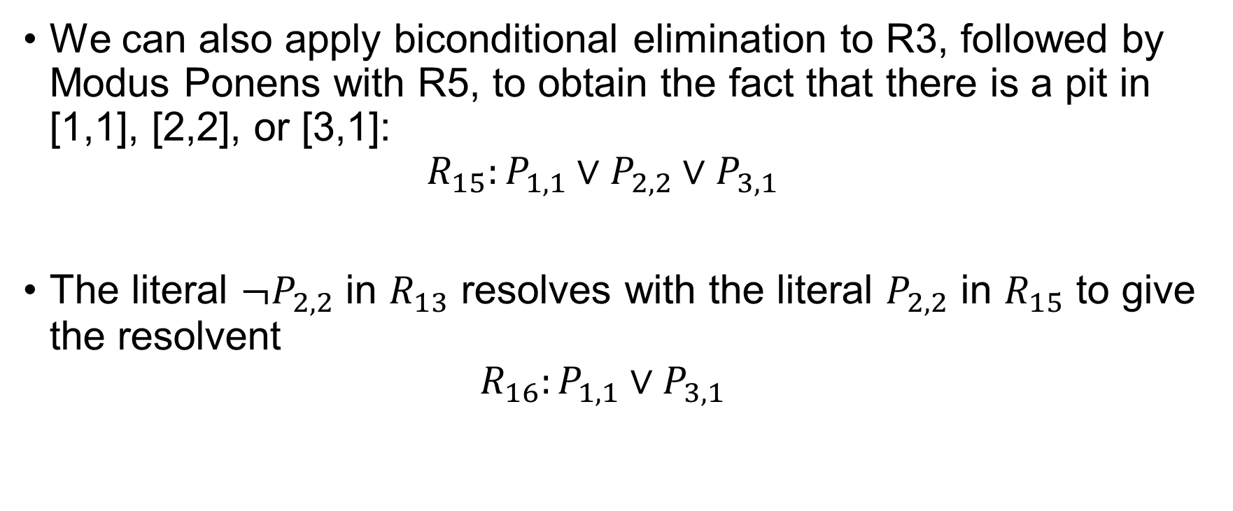
Proof by Resolution
We can also apply biconditional elimination to R3, followed by Modus Ponens with R5, to obtain the fact that there is a pit in [1,1], [2,2], or [3,1]: $R_{15}:P_{1,1}∨P_{2,2}∨P_{3,1}$
The literal $¬P_{2,2}$ in $R_{13}$ resolves with the literal $P_{2,2}$ in $R_{15}$ to give the resolvent $R_{16}:P_{1,1}∨P_{3,1}$

Slide 50
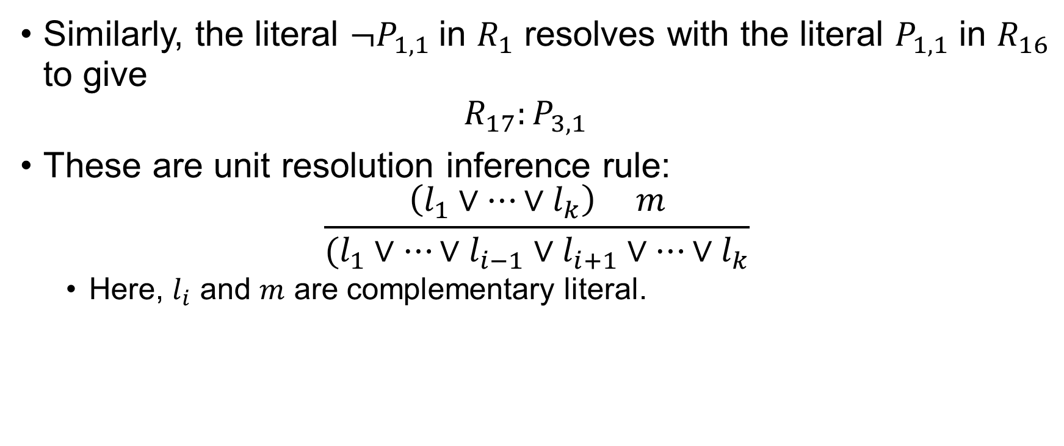
Proof by Resolution
Similarly, the literal $¬P_{1,1}$in $R_{1}$ resolves with the literal $P_{1,1}$ in $R_{16}$ to give $R_{17}:P_{3,1}$
These are unit resolution inference rule: $\frac{\left(l_{1}∨…∨l_{k}\right) m}{(l_{1}∨…∨l_{i−1}∨l_{i+1}∨…∨l_{k}}$
Here, $l_{i}$ and $m$ are complementary literal.

Slide 51
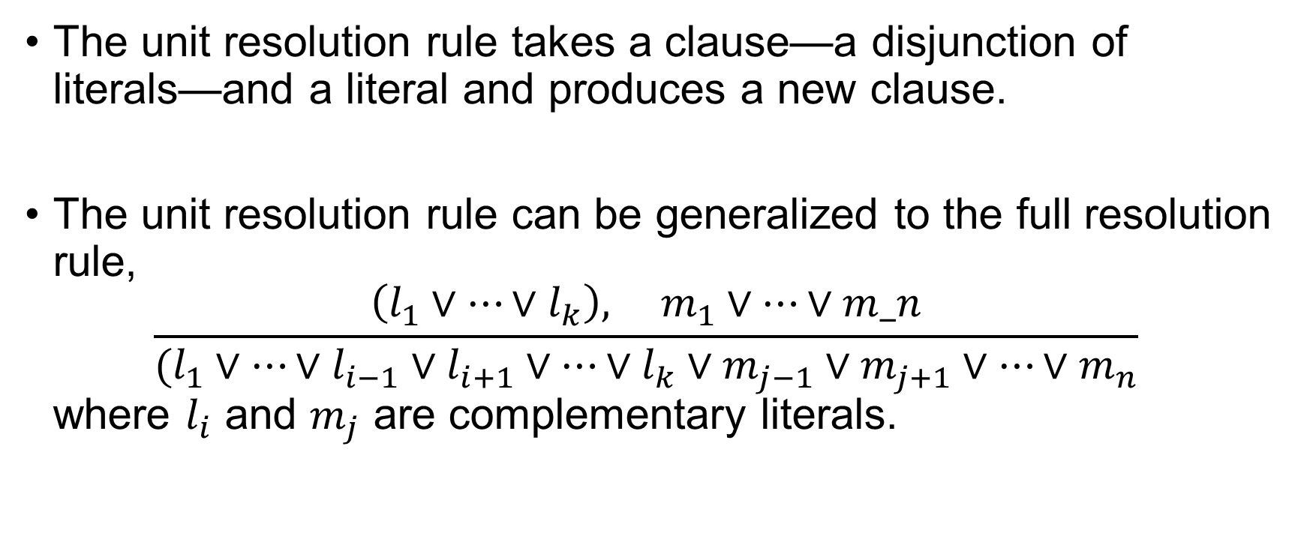
Proof by Resolution
The unit resolution rule takes a clause—a disjunction of literals—and a literal and produces a new clause.
The unit resolution rule can be generalized to the full resolution rule, $\frac{\left(l_{1}∨…∨l_{k}\right), m_{1}∨…∨m_n}{(l_{1}∨…∨l_{i−1}∨l_{i+1}∨…∨l_{k}∨m_{j−1}∨m_{j+1}∨…∨m_{n}}$ where $l_{i}$ and $m_{j}$ are complementary literals.

Slide 52
Proof by Resolution
Factoring
The resulting clause should contain only one copy of each literal.
The removal of multiple copies of literal is called factoring.
We resolve (A ∨ B) with (A ∨¬B), we obtain (A∨A), which is reduced to just A.

Slide 53
Conjunctive Normal Form
The resolution rule applies only to clauses. (Disjunctions and Literals)
Every sentence of propositional logic is equivalent to a conjunction of clauses.
A sentence expressed as a conjunction of clauses is said to be in conjunctive normal form or CNF.

Slide 54
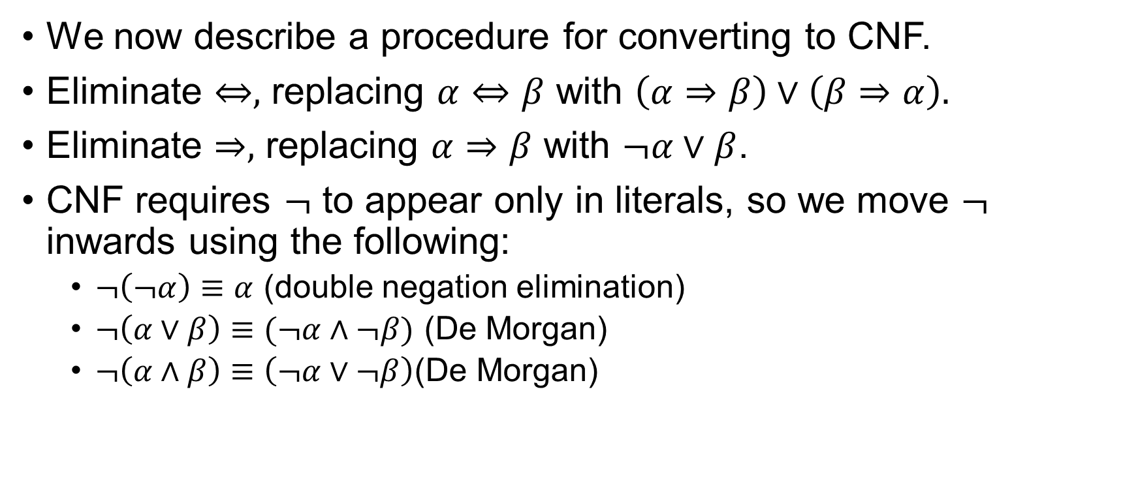
Conjunctive Normal Form
We now describe a procedure for converting to CNF.
Eliminate $⇔,$ replacing $α⇔β$ with $\left(α⇒β\right)∨\left(β⇒α\right).$
Eliminate $⇒,$ replacing $α⇒β$ with $¬α∨β$.
CNF requires $¬$ to appear only in literals, so we move $¬$ inwards using the following:
$¬\left(¬α\right)≡α$ (double negation elimination)
$¬\left(α∨β\right)≡(¬α∧¬β)$ (De Morgan)
$¬\left(α∧β\right)≡\left(¬α∨¬β\right)$(De Morgan)

Slide 55
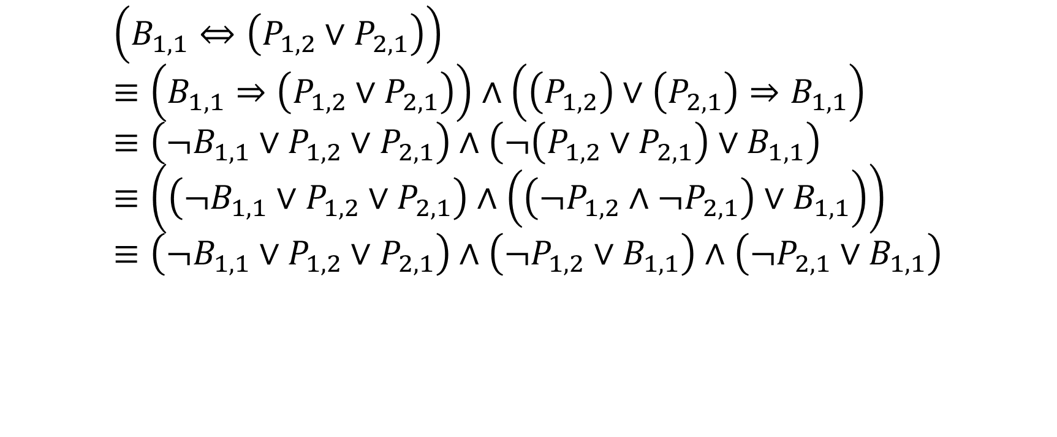
Conjunctive Normal Form
$$\left(B_{1,1}⇔\left(P_{1,2}∨P_{2,1}\right)\right) \\ ≡\left(B_{1,1}⇒\left(P_{1,2}∨P_{2,1}\right)\right)∧\left(\left(P_{1,2}\right)∨\left(P_{2,1}\right)⇒B_{1,1}\right) \\ ≡\left(¬B_{1,1}∨P_{1,2}∨P_{2,1}\right)∧\left(¬\left(P_{1,2}∨P_{2,1}\right)∨B_{1,1}\right) \\ ≡\left(\left(¬B_{1,1}∨P_{1,2}∨P_{2,1}\right)∧\left(\left(¬P_{1,2}∧¬P_{2,1}\right)∨B_{1,1}\right)\right) \\ ≡\left(¬B_{1,1}∨P_{1,2}∨P_{2,1}\right)∧\left(¬P_{1,2}∨B_{1,1}\right)∧\left(¬P_{2,1}∨B_{1,1}\right)$$

Slide 56
Thank You.

